Slide 1
DATA SCIENCE
10 WEEK PART TIME COURSE
Week 2 - Data Visualisation

Slide 2
AGENDA
What is Data Visualisation?
Why do we visualise data?
How do we visualise data?
Lab
Discussion

Slide 3
WHAT IS DATA VISUALISATION?
DATA SCIENCE PART TIME COURSE

Slide 4
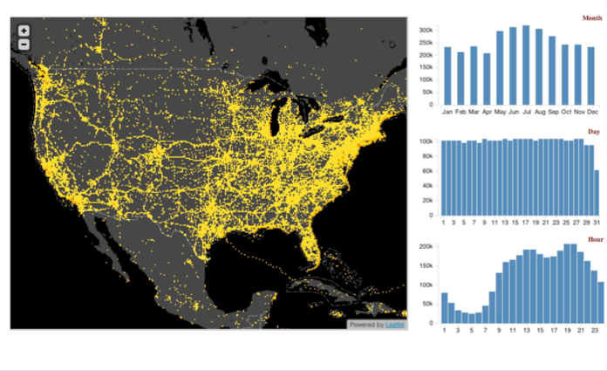
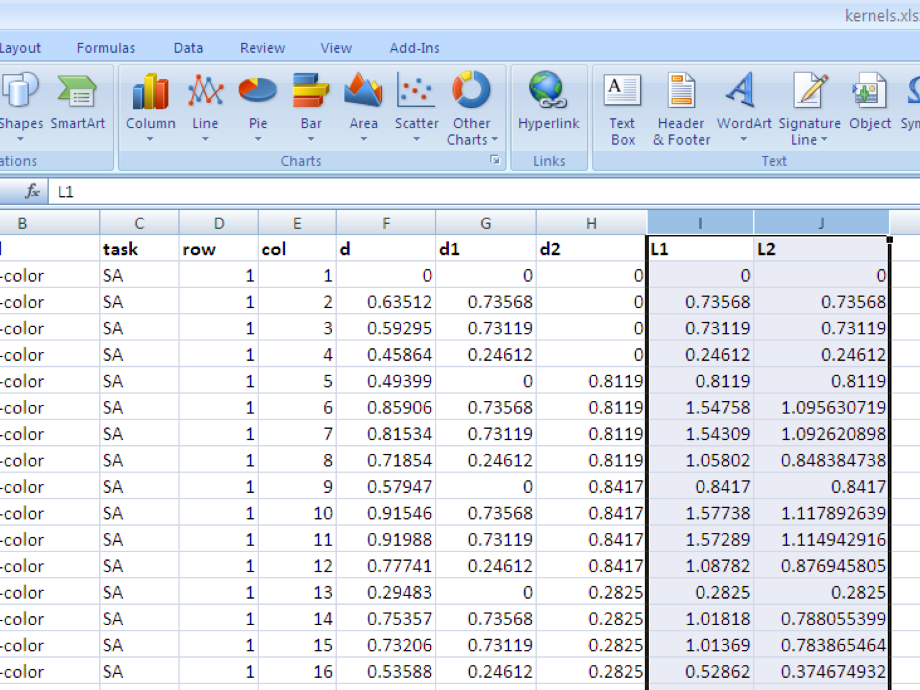
WHAT IS DATA VISUALISATION?
Present information that is intuitive and clear for the viewer
Turn numbers in a spreadsheet into something people can interpret and extract insights

Slide 5
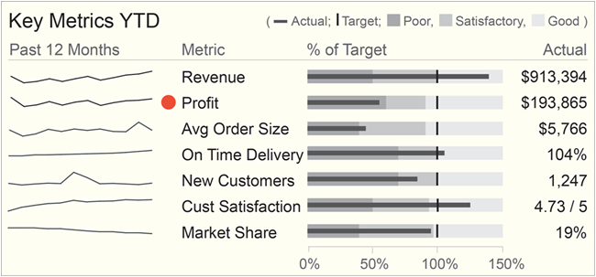
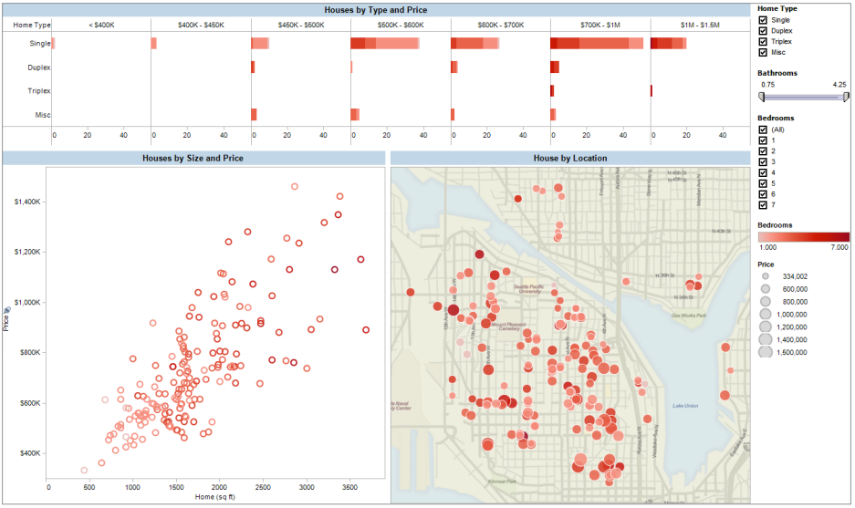
WHY VISUALISE DATA?
Reporting
Dashboards and Business Intelligence
Know the questions you want answers to
Can detect changes from the norm
Good for taking a 30,000 foot view of the problem

Slide 6
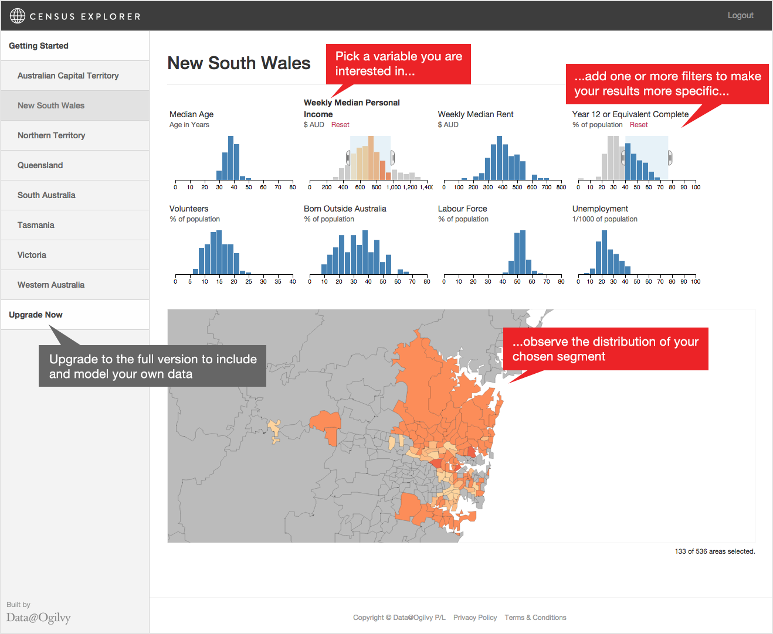
WHY VISUALISE DATA?
Exploring
Exploratory Data Analysis
Combines multiple data sources for single view of a problem
Technical analysis of data
Combined with modelling allows for the discovery of new problems and solutions

Slide 7




HOW DO WE VISUALISE DATA?
Power
Ease of Use

Slide 8
TOOL TRADEOFFS
Easy to Use | Powerful
Provides a useful starting point
Familiar to a large audience
Prototyping and design time is reduced
Default settings reduce the options and thinking that goes into producing a graph
Scales to larger datasets
Customised visualisations can create engaging visualisations
Open-source (so free to run and extend)
Non-obvious insights can be discovered with modelling tools
Re-use code to produce similar charts for different data
Advantages
Reproducing analysis requires lots of manual effort
Limited to relative small data sets
Solves known problems and cannot answer complex questions
Licensing can be expensive
Requires specialist skills to produce a graph
Training and education for some of the output might be necessary
Disadvantages

Slide 9
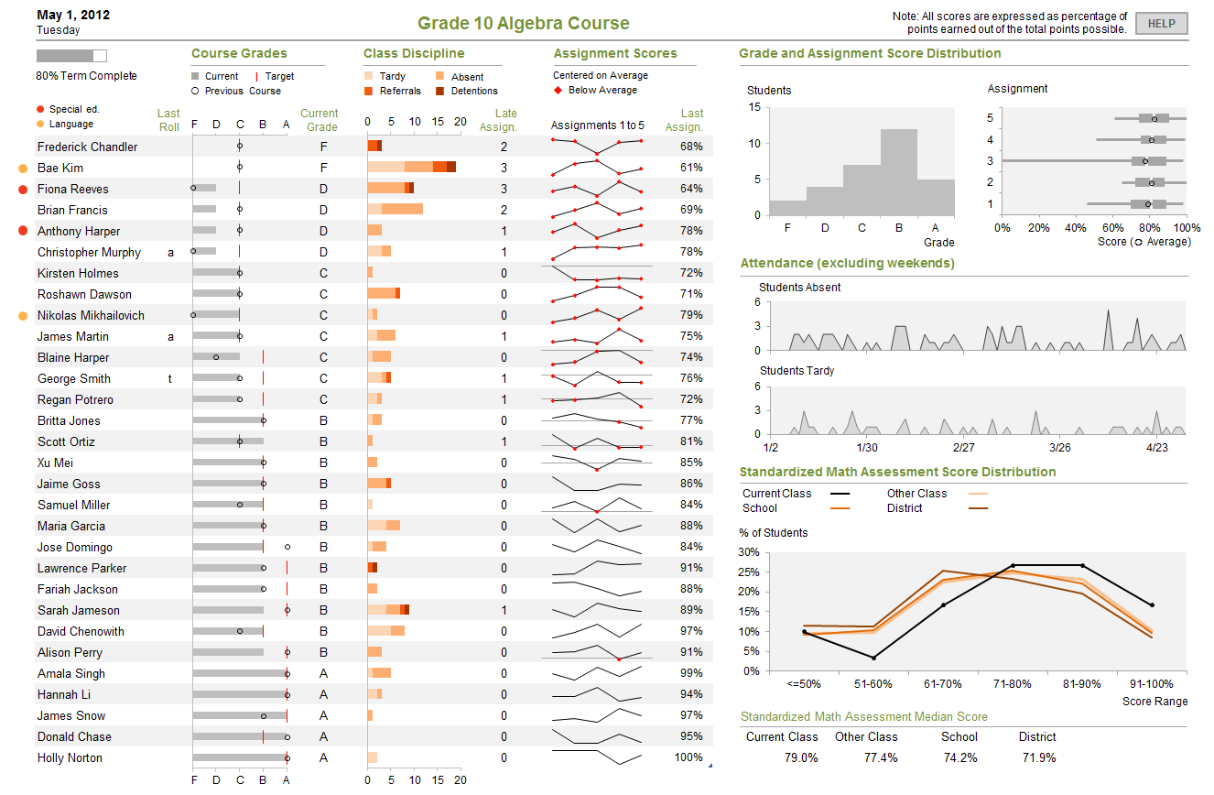
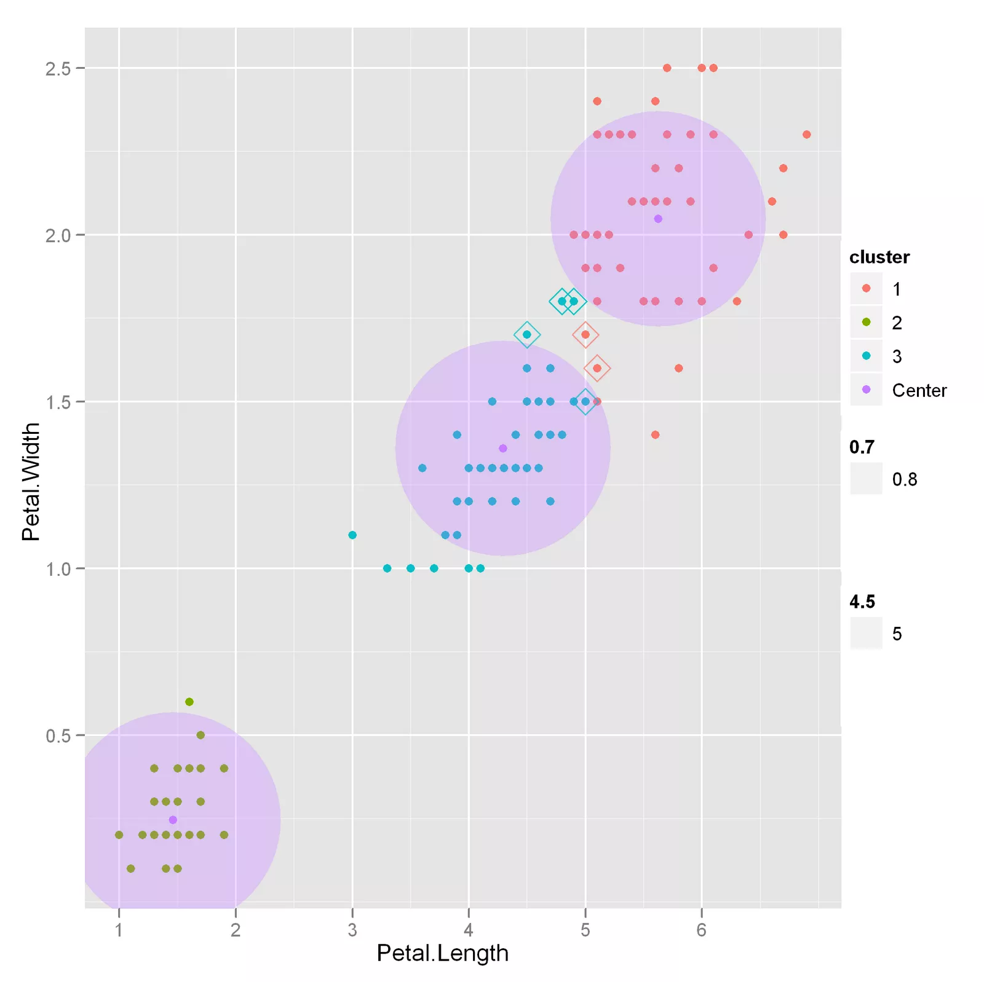
THE VALUE OF DATA VISUALISATION
Communicate what’s happening within the business
Support decisions with information
Measure and report the impact of decisions
Discover ways to improve the business

Slide 10
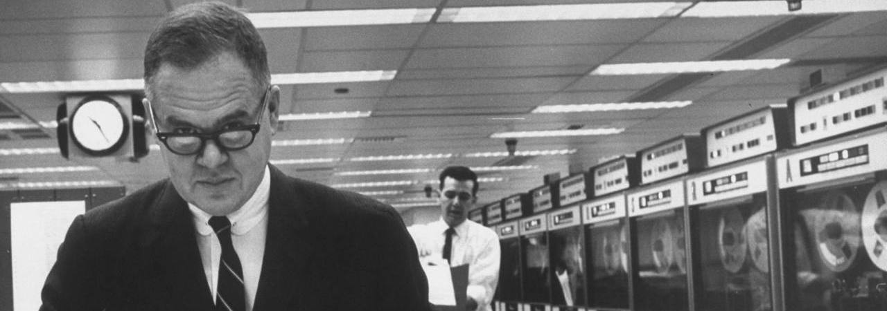

USING DATA SCIENCE PACKAGES
The greatest value of a picture is when it forces us to notice what we never expected to see.
John W. Tukey.
Exploratory Data Analysis. 1977.
DATA SCIENCE PART TIME COURSE

Slide 11
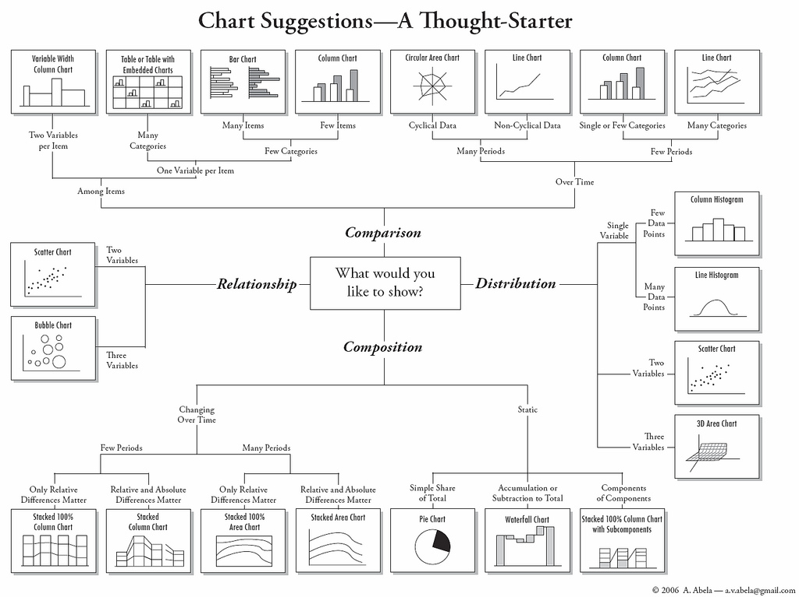

Slide 12
DATA VISUALISATION LAB
DATA SCIENCE PART TIME COURSE

Slide 13
DISCUSSION TIME
DATA SCIENCE - Week 2 Day 1
DISCUSSION TIME
Review of last week
Further Reading for Data Visualisation
Check in with homework/course project

Slide 14
WEEK 1

Slide 15

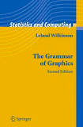
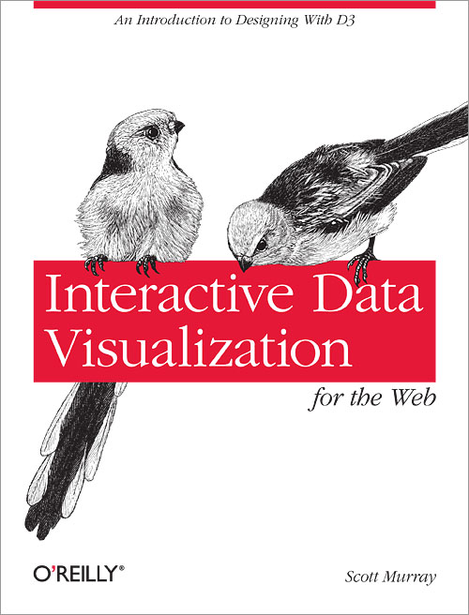
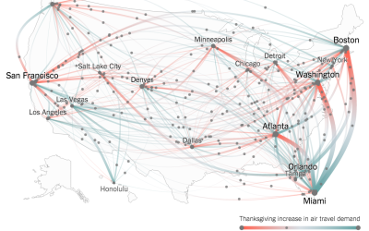
DISCUSSION TIME
Further Reading
Edward Tufte, The Visual Display of Quantitative Information
Leland Wilkinson, The Grammar of Graphics
Scott Murray, Interactive Data Visualisation for the Web (free online)
flowingdata.com
New York Times (Upshot)
DATA SCIENCE - Week 2 Day 1

Slide 16
DISCUSSION TIME
Homework/Course Project
How’s it going ?
DATA SCIENCE - Week 2 Day 1

